Slide 1

Analysis of Runs Scored in One – Day Cricket
- Suneeth Ravilla

Slide 2
Objective of Analysing the dataset
To identify the relationship between variables to obtain useful and usable information of Runs scored by batsmen
Analysing runs scored by players w.r.t. their country’s using Frequency and Statistical analysis.
Using correlation function to analyse variables affecting runs scored by batsmen.
Scatter plot analysis of variables contributing to runs scored.
Performing analysis of strike rate vs runs scored by players using a bar plot.

Slide 3
Summary of Data Set
This Dataset contains runs scored by batsmen from different teams in one day cricket and the factors involved during the runs scored.
Original dataset contains 15 Variables and 1400+ records
Mostly data set contains numeric values
Player
Country
Matches played
Innings
Not Outs
Runs
Highest Score
Average
Balls Faced
Strike Rate
100’s
50’s
0’s
4’s
6’s

Slide 4
Variables for Analysis
Batsmen who played at least 50 Matches during 1989 to 2019
Only the top 10 countries are part of this analysis
Out of 15 variables, I considered only 5 variables which are significant in analysing the runs scored using 400+ records
Country – Country which batsmen is representing
Runs – Runs scored by batsmen in his career
Average – Average runs scored in each match
Balls Faced – Number of balls scored in his career
Strike Rate – Percentage of number of runs scored per ball

Slide 5
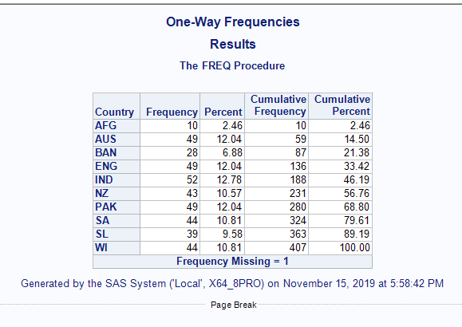
Frequency Analysis
Frequency of Country:
Analysing frequency count of players w.r.t country they are representing.
Highest Frequency = 52 (IND)
Lowest Frequency = 10 (AFG)
From this, we can analyse that, India produces good batsmen than any other country.

Slide 6
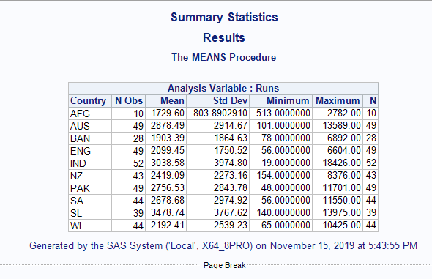
Statistical Analysis
Mean:
Average Runs scored by players at each Country level
Sri Lankan batsmen have scored more runs with Mean of 3878.74
Even though India produces high scoring batsmen it has lower mean compared to Sri Lankan batsmen due to high Std. Deviation of 3974.80

Slide 7
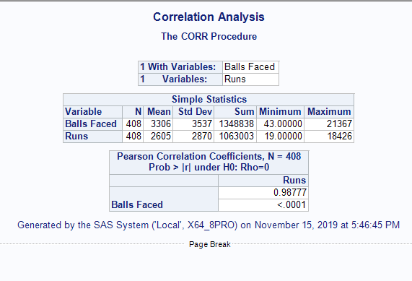
Correlation Analysis
Correlation:
Runs Scored vs Balls Faced
There is a high correlation among Runs scored vs Balls Faced
Correlation = 0.98
Batsmen who scored more Runs has faced more number of balls.

Slide 8
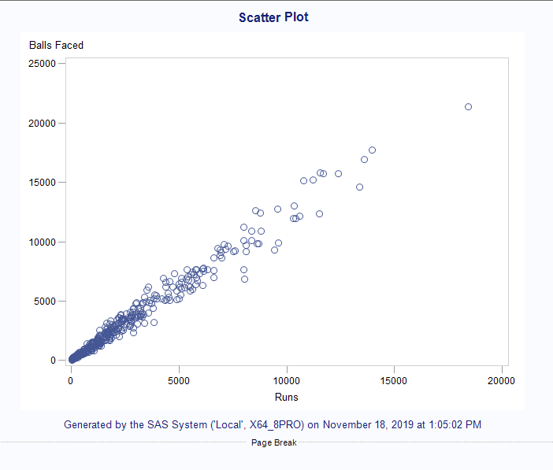
Scatterplot Analysis
Scatter Plot
The graph follows a pattern which shows Runs scored and Balls faced are correlated with each other falling on the same line.
As the Runs scored increases, balls faced also increased which shows the correlation is high between these 2 variables.

Slide 9
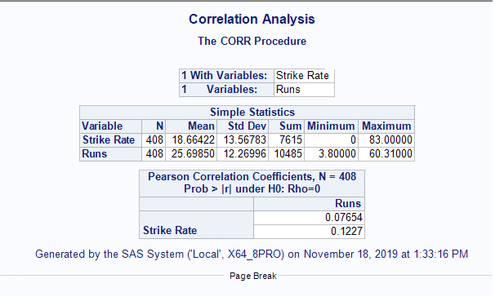
Correlation Analysis
Correlation:
Runs vs Strike Rate
There is a least correlation between Runs and Strike rate
Correlation = 0.07
By analysing this we can conclude that the Strike rate is not effecting in scoring runs.

Slide 10
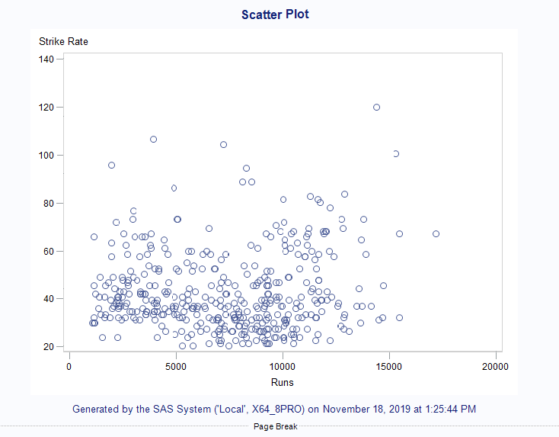
Scatterplot Analysis
Scatter Plot
By looking at the graph, we can see that there is no pattern to determine any correlation between Runs scored and Strike rate.
The points were scattered all over the graph which is indicating neither of the variables is dependent on others.

Slide 11
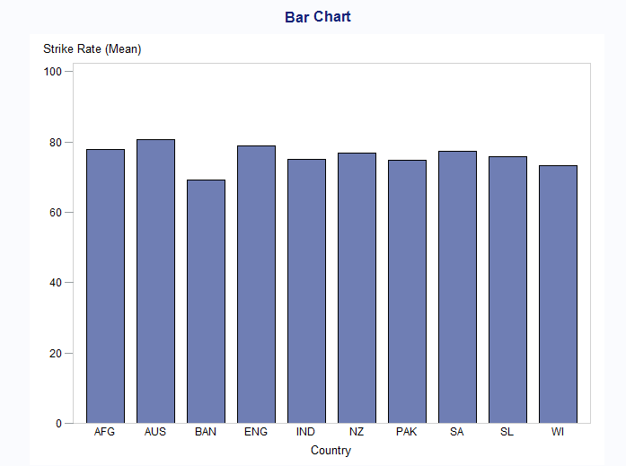
Bar Plot Analysis
Bar Plot:
Country vs Strike Rate
Almost all the countries have the same average strike.
Australia is having the highest average strike rate of 80.
Bangladesh is having the lowest average strike rate of 70.
Even though the average strike rate of players is maintained it doesn’t help them in scoring more runs.

Slide 12
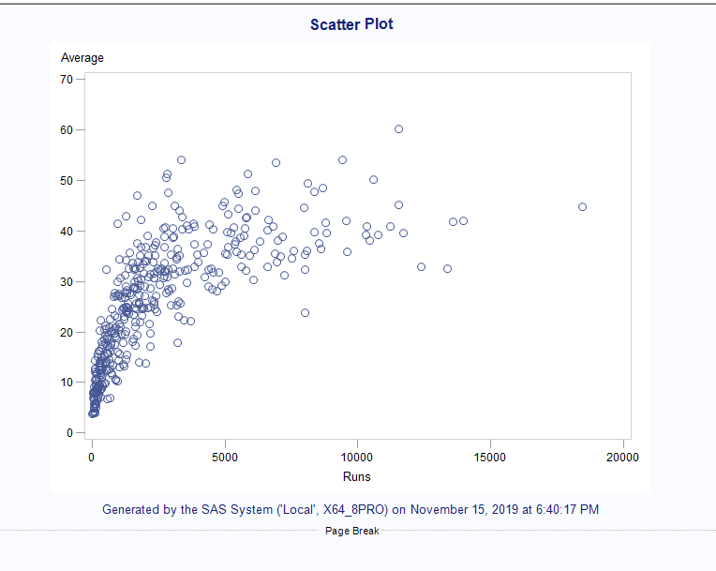
Scatterplot Analysis
Scatter Plot:
Runs vs Average
The scatterplot shows the trend of the points as the runs scored is high average is also high.
From the analysis, batsmen scoring more runs tend to maintain the higher average.

Slide 13
Conclusion
Batsmen need to face more Number of balls
Batting Average should be maintained
India holds the most number of players in the top scoring list of batsmen who played at least 50 matches.
Even though India produces more number of players it does not have the highest mean due to the high variation in the runs scored.
There is a high correlation between runs scored vs balls faced when compared to all the variables affecting runs scored.
Strike Rate will not effect batsmen scoring runs
We observed the least correlation between runs scored vs strike rate even though the average strike rate of all the teams are almost the same.
Analysing runs with average, batsmen who scored more runs has maintained a good average.
Finally, in order to score more runs, batsmen have to face more number of balls while maintaining a good average irrespective of strike rate.

Slide 14
Source
http://stats.espncricinfo.com/ci/content/records/83548.html

Slide 15
THANK YOU!
Any questions?

